Slide 1
City of St. Augustine Beach
Civil Engineering for 7th, 8th, and 9th
Street Drainage Improvements
11/02/2023

Slide 2
Presentation Outline
Civil Engineering for 7th, 8th, and 9th
Street Drainage Improvements
Intro & Project Team
Project Overview
2

Slide 3
Firm
Background
Founded in 1995
Nearly 3 Decades of Service to Alachua County
Tallahassee
St. Augustine
50 employees
Alachua County SBE
(Certified Small Business)
6 Licensed Professional Engineers
Gainesville

Slide 4
Intro & Project Team
4

Slide 5
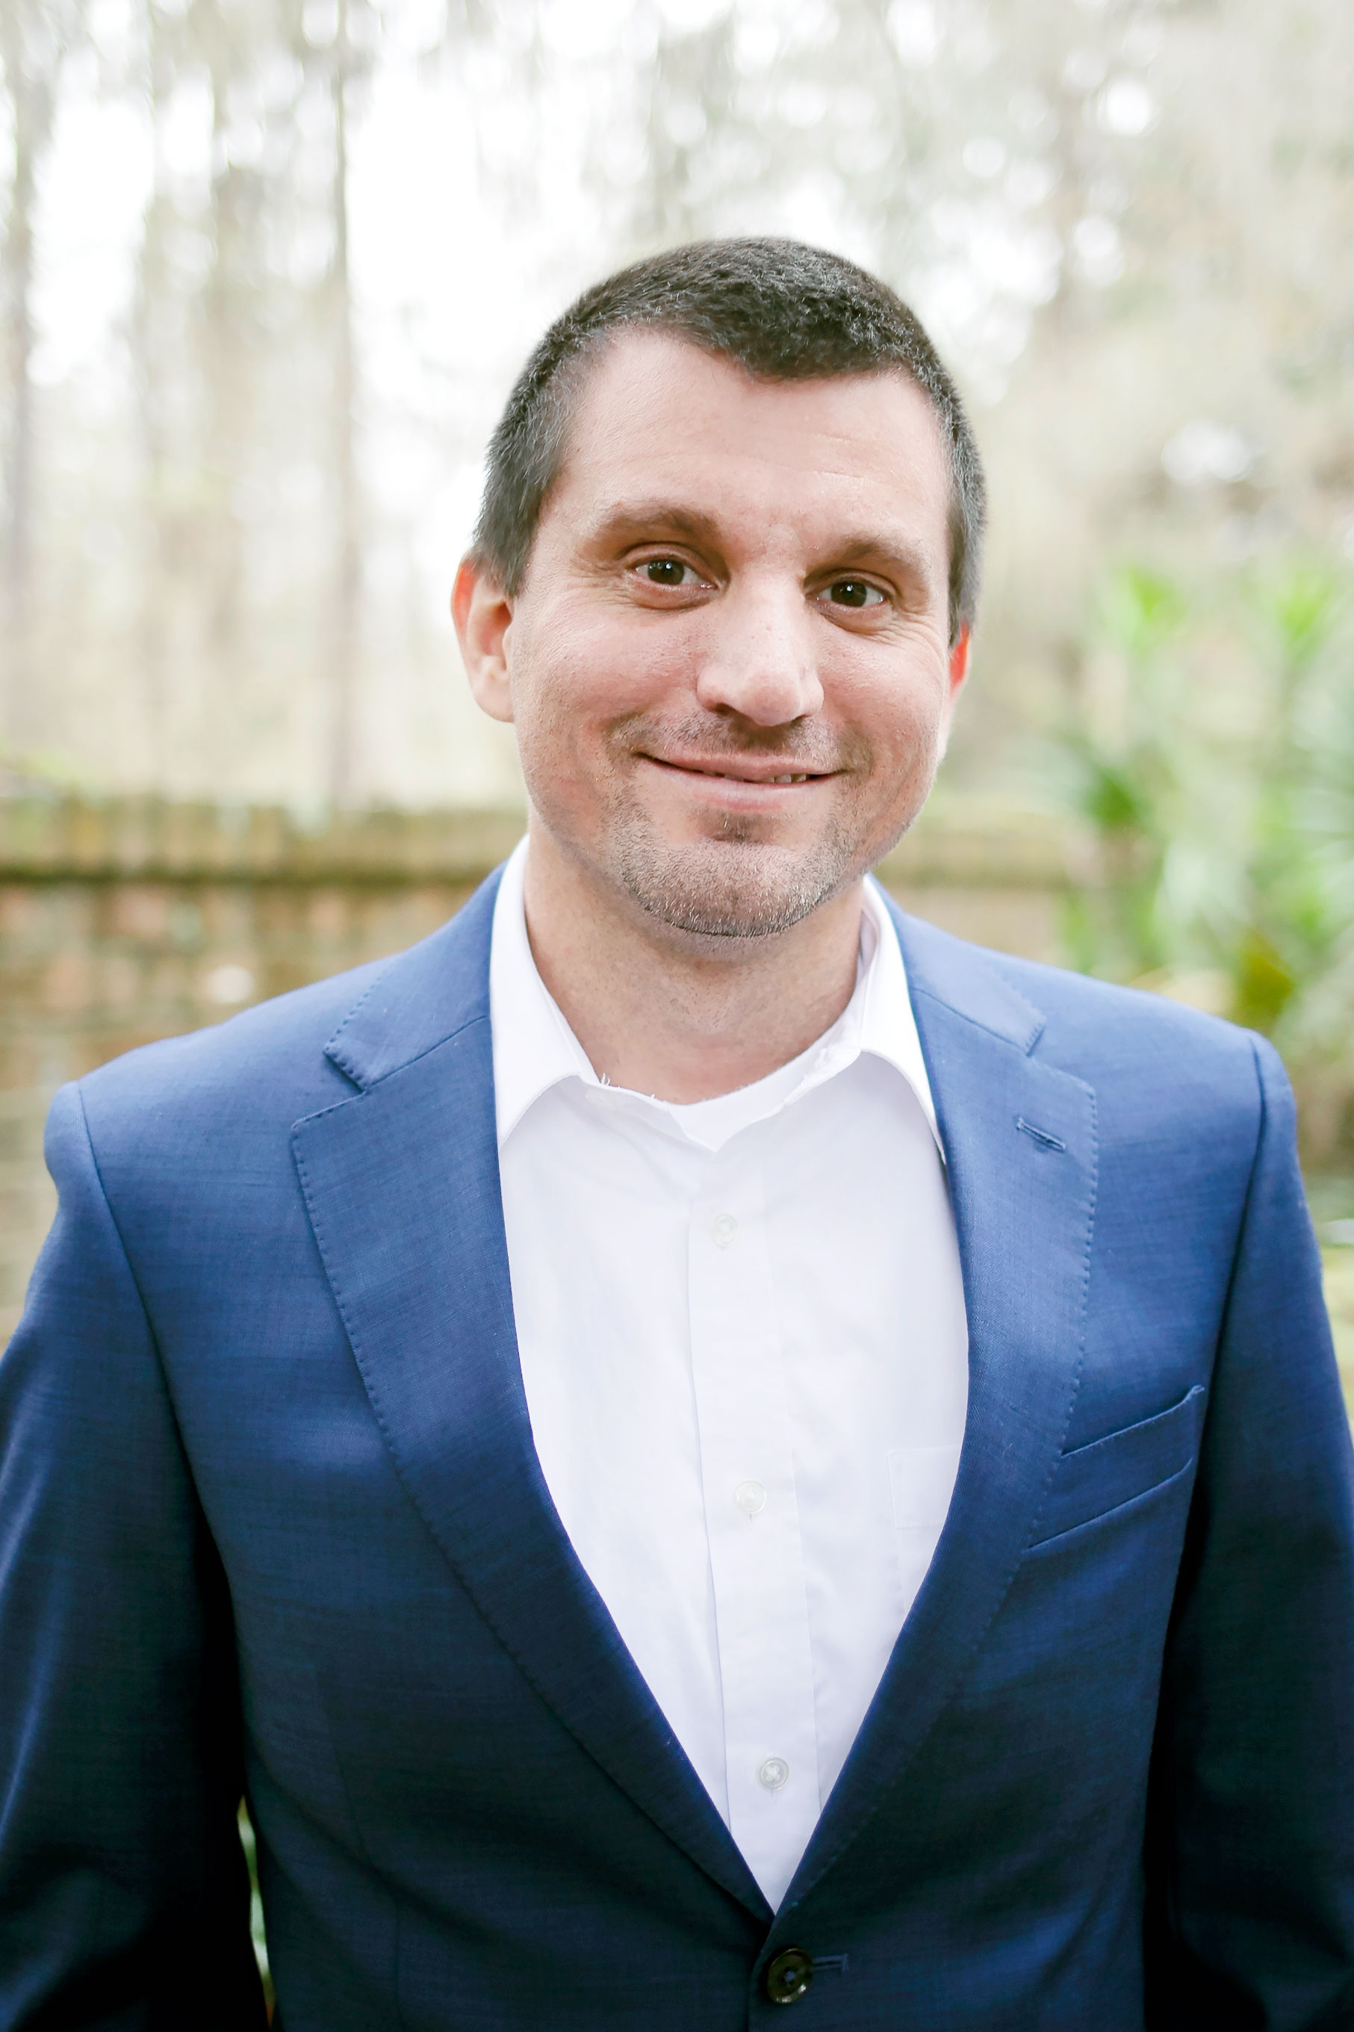
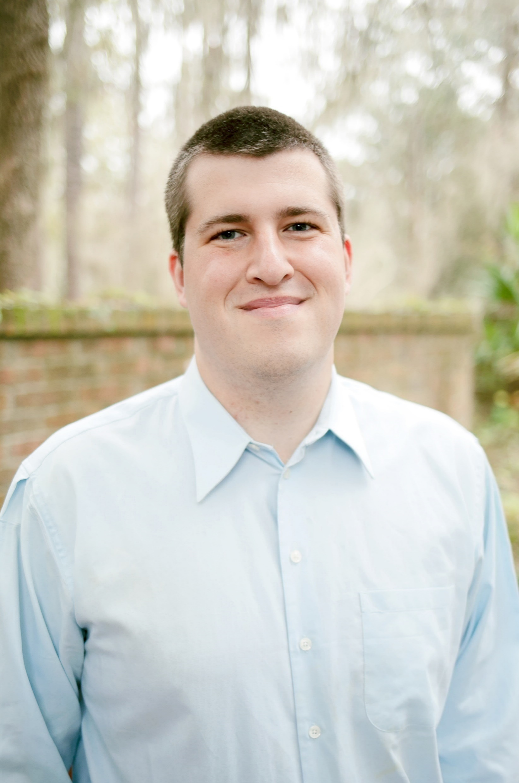
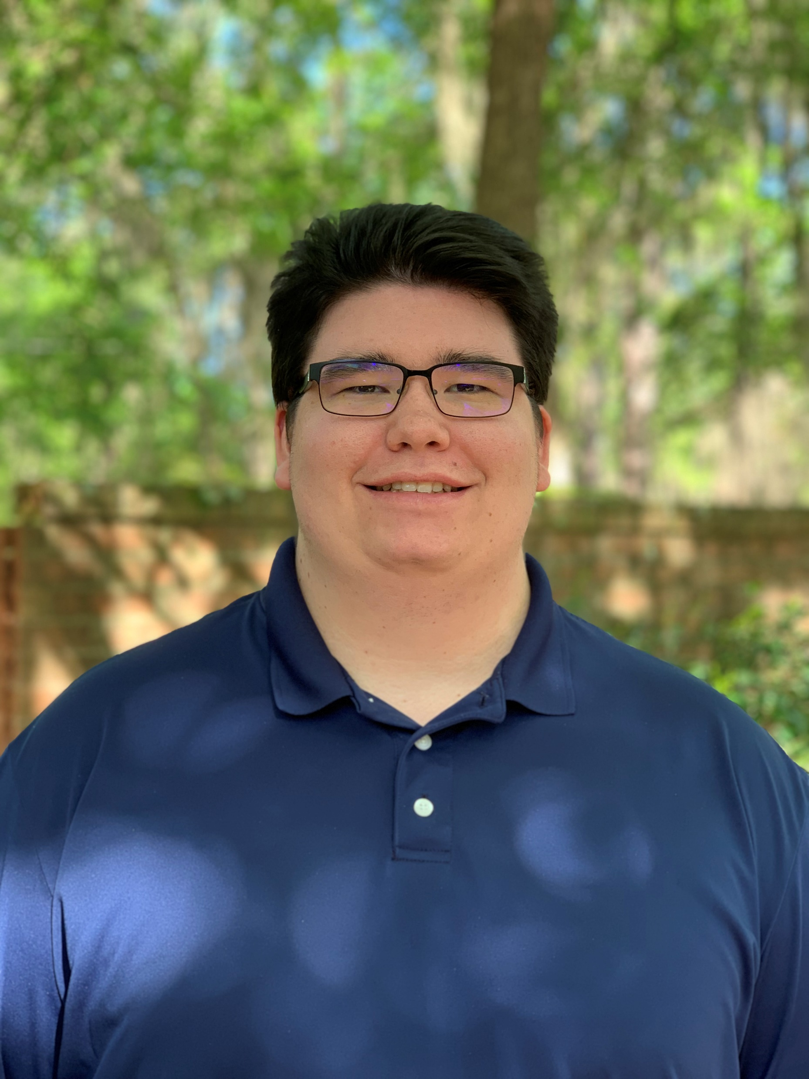
Team Introductions & Project Roles
Chris Potts,
PE, LEED GA
Director of Engineering
16 Years of Experience
Tim Boehlein,
PE, LEED GA
Project Manager &
Engineer of Record
4 Years of Experience
Gabe Sanz, EI
Lead Design Engineer
2 Years of Experience
5

Slide 6
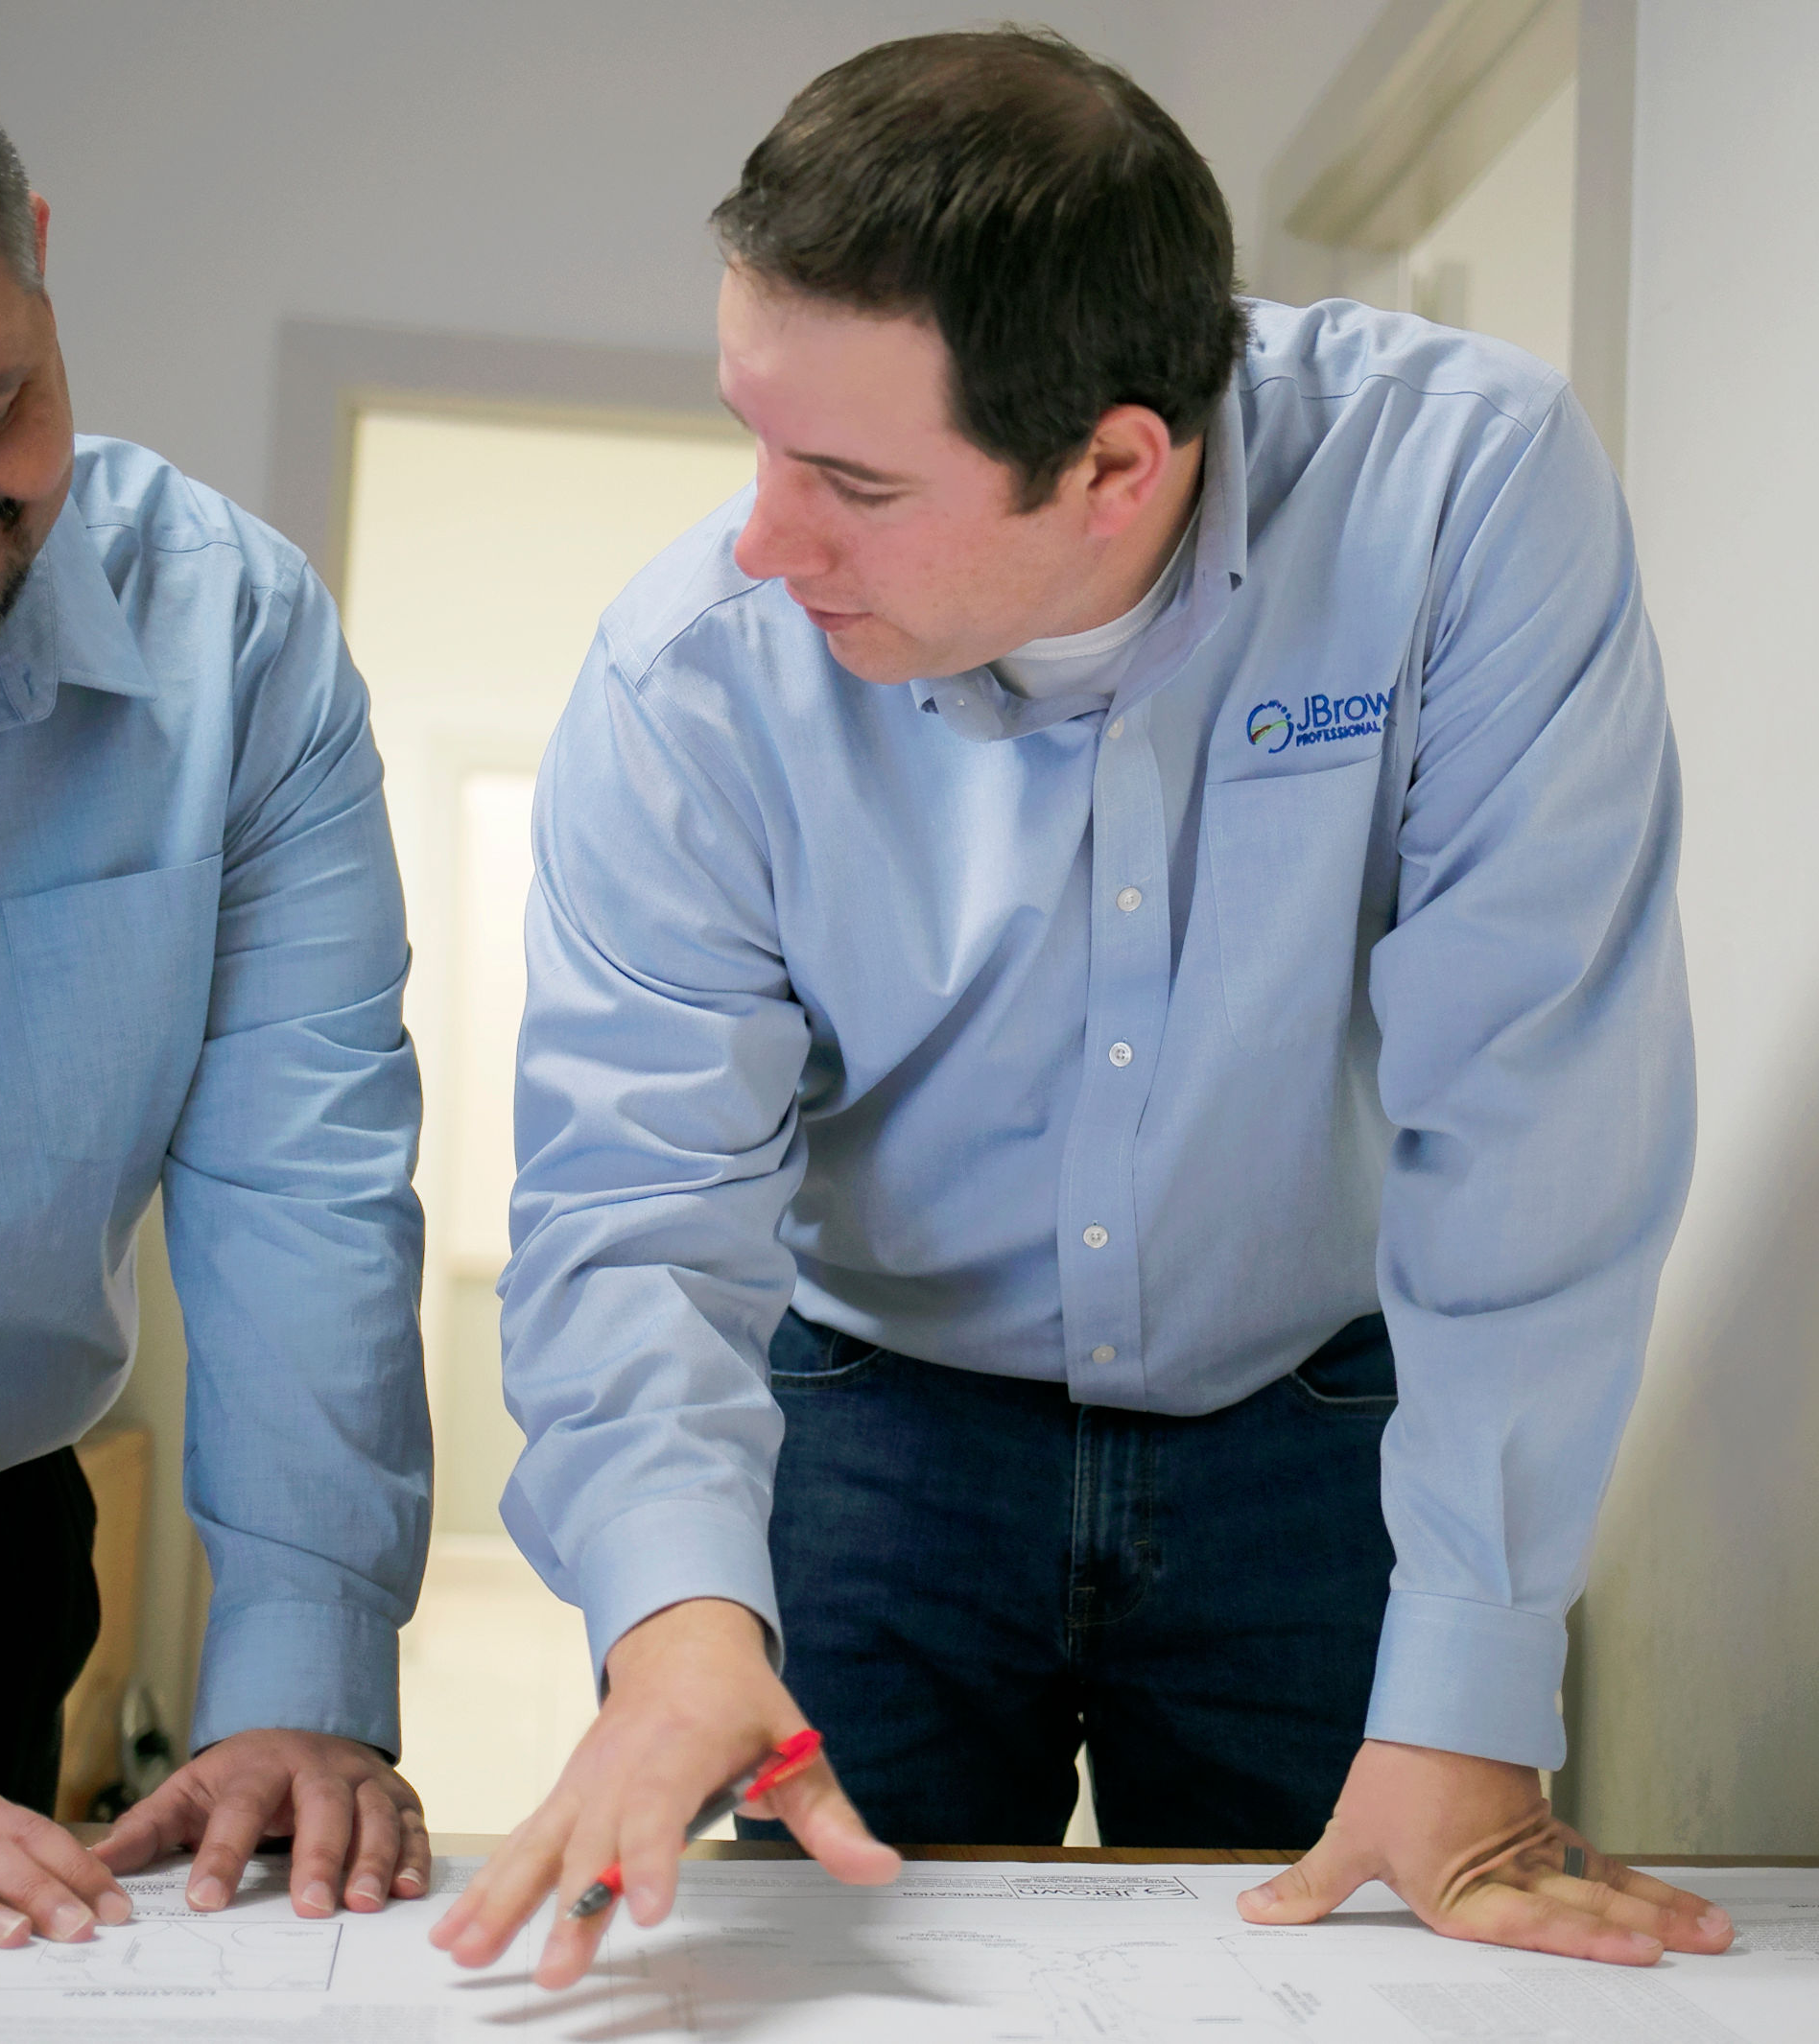
Project Overview
6

Slide 7
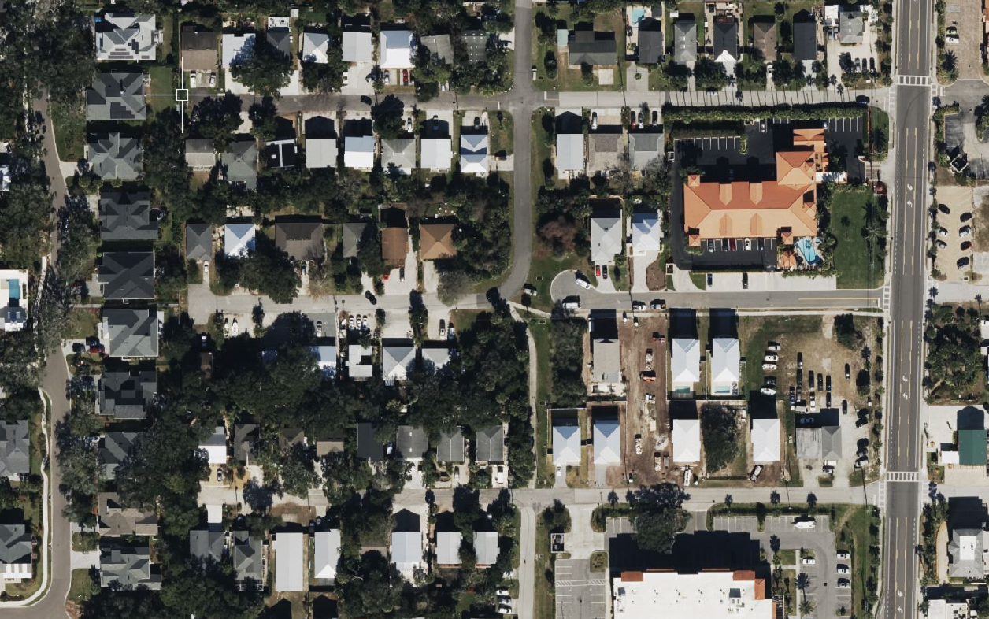
Project Overview
Background
General Information
Project within the Right-Of-Ways of 7th, 8th, and 9th Streets
Total Project Area – 0.46 Acres
Project Goal – Improve the existing roadway and stormwater conveyance systems on each street to ensure proper drainage is maintained
9th Streeti
2nd Avenuei
A1A Beach Blvdi
8th Streeti
Rrideway Roadi
7th Streeti
7

Slide 8
Project Overview
Key Issues – Stormwater
SJRWMD ERP Exemption
City of St. Augustine Beach
Example of improper drainage / flooding on 9th Street
7th Street
8th Street
9th Street
8
8

Slide 9
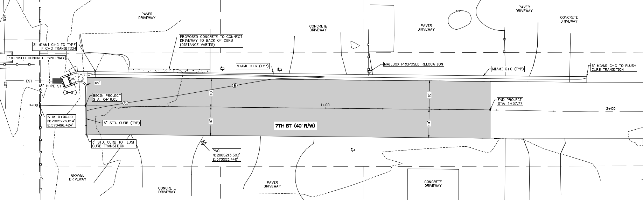
Project Overview
Key Issues – Stormwater Cont.
Proposed 7th Street Improvements
Proposed 8th Street Improvements
Proposed 9th Street Improvements
9
9

Slide 10
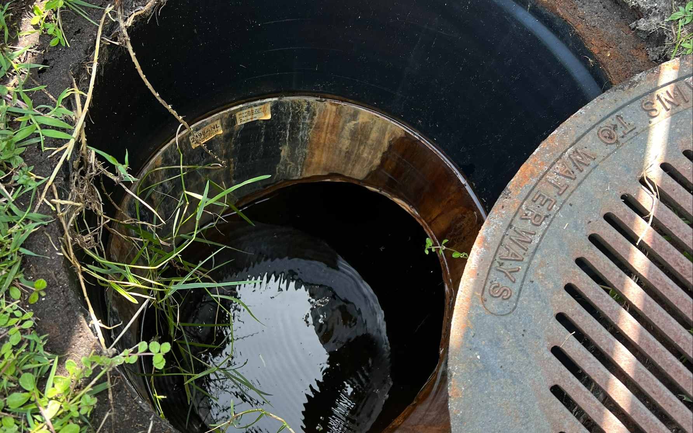
Project Overview
Key Issues – Utilities
Existing Utilities within the Right-Of Ways
Potable Water
Wastewater
Overhead Electric
Fiber / Cable
Gas
10
10

Slide 11
Q&A

