Slide 1
Illicit Discharge Training

Slide 2
GOALS
Understand the terms “Stormwater” , “Illicit Discharge” and “Best Management Practice (BMPs)”
Understand why these terms are important and why you should care
Understand what BMPs you can use to help prevent Stormwater pollution
Understand how to recognize and report Illicit Discharges (pollution)
Notes:
Throughout this presentation, pay attention to key words such as “Stormwater Runoff,” “Illicit Discharge,” and “Best Management Practice or BMP.” By the end of this presentation, you should know what these terms mean and why they are important. You’ll also know how to identify and properly report Illicit Discharges.

Slide 3
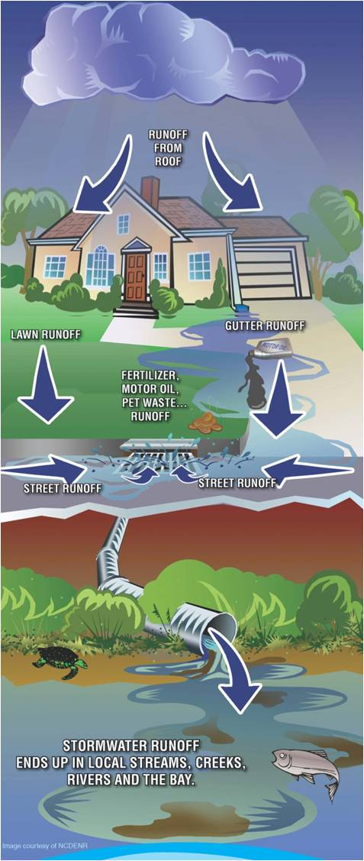
WHAT IS STORMWATER?
When it rains, water that does not soak into the ground becomes runoff.
This runoff can enter a storm drainage system which ends up in local streams, creeks, rivers, Intracoastal waterways and even the ocean.
Notes:
Let’s start with rain. Stormwater is simply any rain that does not soak into the ground and runs off into a ditch, storm drain, or surface water. When it rains, water will either soak into the ground, or it will hit a hard or “impervious” surface and will run off somewhere else. When this water falls on a driveway or parking lot, it may carry with it oil, fuel, heavy metals or sediment. When water runs off of a lawn, it might have fertilizer, pesticides, dog waste, or sediment in it. All of these pollutants that are carried by the water as it runs off will eventually make their way into our rivers, creeks, streams, intra-coastal waterways, and even out in to the ocean.
Image Credit: https://www.montgomerycountymd.gov/water/stormwater/about.html

Slide 4
STORMWATER POTENTIAL IMPACT
Stormwater runoff can pick up debris, chemicals, dirt, and other pollutants
Stormwater runoff is NOT treated before it is discharged into local streams, creeks, rivers, ICCW and ocean
Notes:
Our county has a sewage treatment system that transports waste water from our homes and businesses to a sewage treatment plant where the polluted water is treated and can then be used to irrigate parks and other public areas. This is important, the storm water system is not part of the sewage system; therefore, the water that goes into the storm drains along with any pollutants ends up in our water bodies, if it’s on the ground it’s in our water bodies. “Storm drains should never have anything in them except clean rain water.”
Image Credit: https://www.readingpa.gov/content/illicit-discharge-reporting

Slide 5
Before Development After Development
Notes:
When rainwater falls on an undeveloped natural area, a lot of it will soak into the ground. As more impervious surfaces like roads, buildings, parking lots and driveways are built; the water has less area to soak in to and instead runs off to the lowest point. As we all know, St. Johns County is growing both in population and in developed areas. The more developed areas and impervious surface, in watershed, the more runoff we will have. The more runoff we have, the more pollution we will have in our water bodies.
Image Credit: https://www.covingtonwa.gov/city_departments/publicworks/swm/swm.php

Slide 6
BRIEF HISTORY OF PHASE II NATIONAL POLLUTION DISCHARGE ELIMINATION SYSTEM PERMIT
In 1990, the Environmental Protection Agency (EPA) created the National Pollution Discharge Elimination System Permit, otherwise known as the NPDES Permit.
Designation originally based of population size and was designated for large to medium municipalities.
Prior to this, the EPA only required permits for traditional point sources of pollution discharge. Ex. Wastewater treatment plant or Industrial Process Wastes
In 1999, the EPA created the “Phase 2” NPDES Permit for smaller municipalities.
St. Johns is recognized under this “Phase 2” designation.
In October 2000, EPA delegates the NPDES Permit to Florida Department of Environmental Protection (FDEP).
Notes:
What is a watershed? Simply put, it’s an area of land that drains to a body of water. Everyone in the world lives in a watershed so we all have a stake in keeping our water bodies clean and safe. Three agencies with major responsibilities for clean water are the EPA, U.S. Environmental Protection Agency; FDEP, the FL. Dept. of Environmental Protection, and the St. Johns County government.

Slide 7
Six Minimum Control Measures
Public Education and Outreach | Perform education outreach regarding the harmful impacts of Stormwater Pollution.
Public Participation/Involvement | Comply with State and local public notice requirements and encourage other avenues for citizen involvement.
Illicit Discharge Detection and Elimination | Implement a plan to detect and eliminate any non-Stormwater discharges to the Municipal Separate Storm Sewer System (MS4) and create a system map showing outfall locations.
Construction Site Runoff Control | Implement and enforce an erosion and sediment control program for construction activities.
Post-Construction Runoff Control | Implement and enforce a program to address discharges of post-construction Stormwater runoff from new development and redevelopment areas. (NOTE: This minimum control measure is met by the State’s Stormwater permitting program under the Water Management Districts, as a “qualifying alternative program,” thus there is no additional requirement for St. Johns County for this measure.)
Pollution Prevention/Good Housekeeping | Implement a program to reduce pollutant runoff from municipal operations and property and perform staff pollution prevention training
Notes:
The County’s NPDES permit is comprised of 6 minimum control measures. These measures, or BMPs assure the three government entities that the county will have sufficient control over the storm water to eliminate polluted storm water runoff from entering our water bodies. Public involvement is critical. Clean-ups and reporting illicit discharge are two task that are easier to get the public to buy into once people understand how important clean water bodies are to our quality of life. Our IDDE program will help eliminate pollution by detecting the pollution before it becomes a problem. We also must have a strong erosion and sediment control program. This means there will be penalties for noncompliance. An example is the correct use of silt fence on new construction sites and it’s also very important to be sure our employees understand the importance of the IDDE program and trained to report any illicit activities.

Slide 8
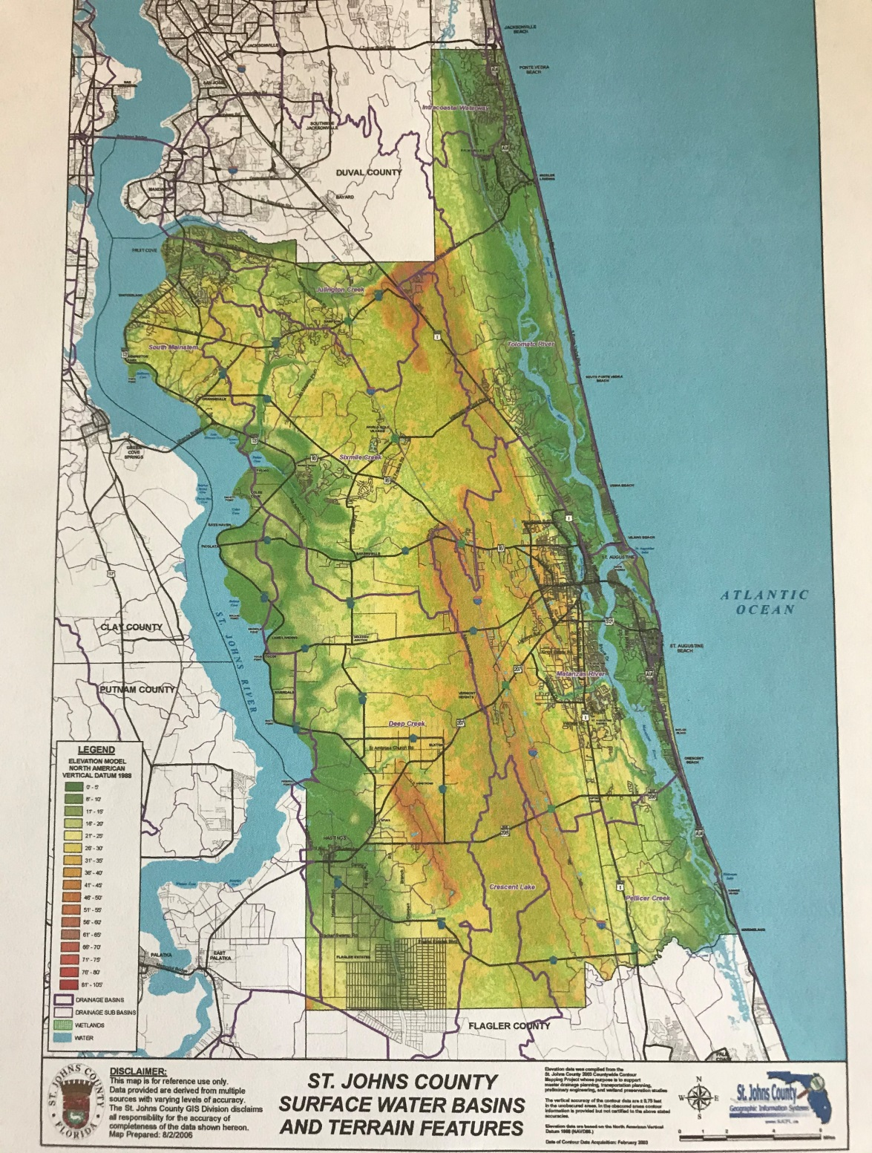
ST. JOHNS COUNTY’S MAJOR WATERSHEDS
Surface Water Basins & MS4 Outfalls
St. Johns River
Intra-coastal Waterway
Guana, Tolomato and Matanzas Rivers
Atlantic Ocean
Notes:
In St. Johns County we have several watersheds in the green area. These are outfalls where storm water runoff goes into a water body. These outfalls are identified, mapped and monitored to assure that there is no polluted water going into the lakes, streams, rivers and ocean. When there is a polluted outfall the county will determine where the illegal discharge is occurring and remedy the situation. All of this process is called the county’s IDDE Program. Remember, detection and elimination of pollutants is what we want to happen.

Slide 9
WHAT CLASSIFIES AS AN ILLICIT DISCHARGE?
Any direct or indirect discharge to the storm sewer system that is not made entirely of Stormwater or is authorized by the County .
Exceptions include:
Water line flushing
Runoff or return flow from landscape irrigation
Discharges from potable water sources
Diverted stream flows
Rising ground waters and springs
Uncontaminated ground water infiltration
Uncontaminated pumped ground water
Foundation and footing drains
Air conditioning condensation
Water from crawl space pumps
Individual residential vehicle washing
Flows from wetlands and riparian habitats
Dechlorinated swimming pool discharges
Discharges or flows from fire fighting activities
Etc.
Notes:
The word “illicit” simply means illegal. An illicit discharge is more than just dumping chemicals down the storm drain. In St. Johns County, it is illegal for anything but storm water to go down a storm drain or into a water body. There are some exceptions to this rule, but if you can remember “Only Rain Goes Down the Drain,” you can easily remember what our County ordinance says.

Slide 10
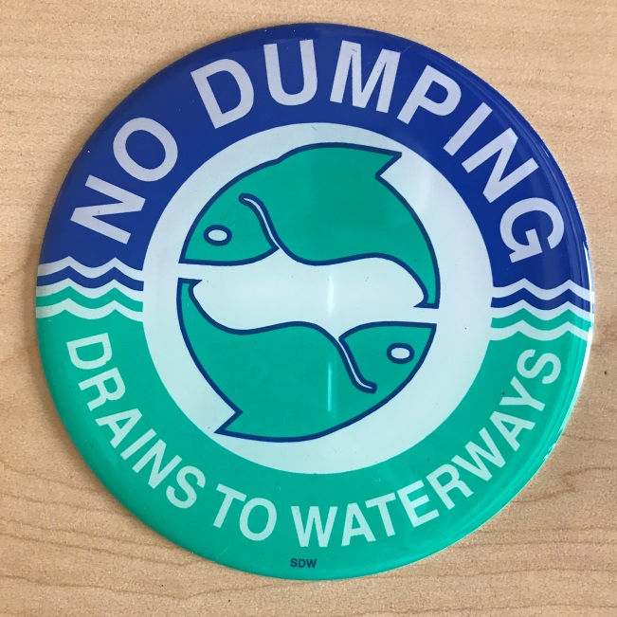
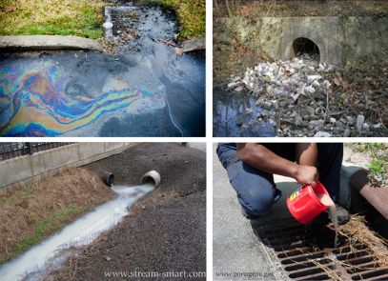
ILLICIT DISCHARGE IMPACTS
Illicit discharges often include pathogens, nutrients, toxic pollutants, etc.
Illicit discharges = pollution
Anything that enters a storm sewer system flows untreated to a local waterway
Notes:
Illicit discharges, such as water containing excess fertilizer or water from the cleaning of painting cans might contain harmful pollutants. These pollutants go directly into our water bodies.
Image Credit #1: Cheryl McCrory
Image Credit #2: https://www.neefusa.org/nature/water/lesson-1-watershed-basics
Image Credit #3: http://rocklandcce.org/stormwater-consortium-water-quality-education/why-keep-storm-drains-clean

Slide 11
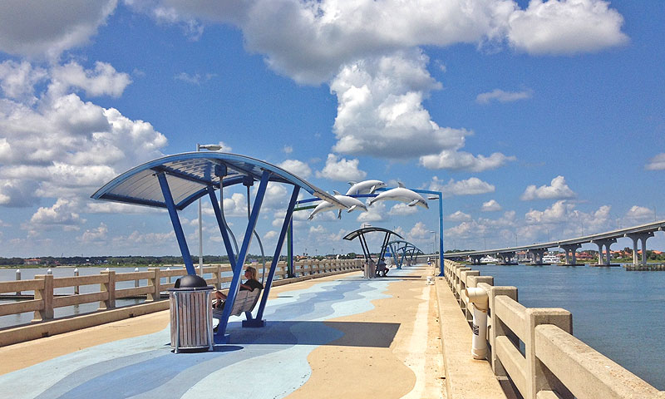
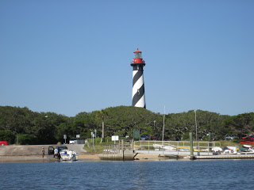
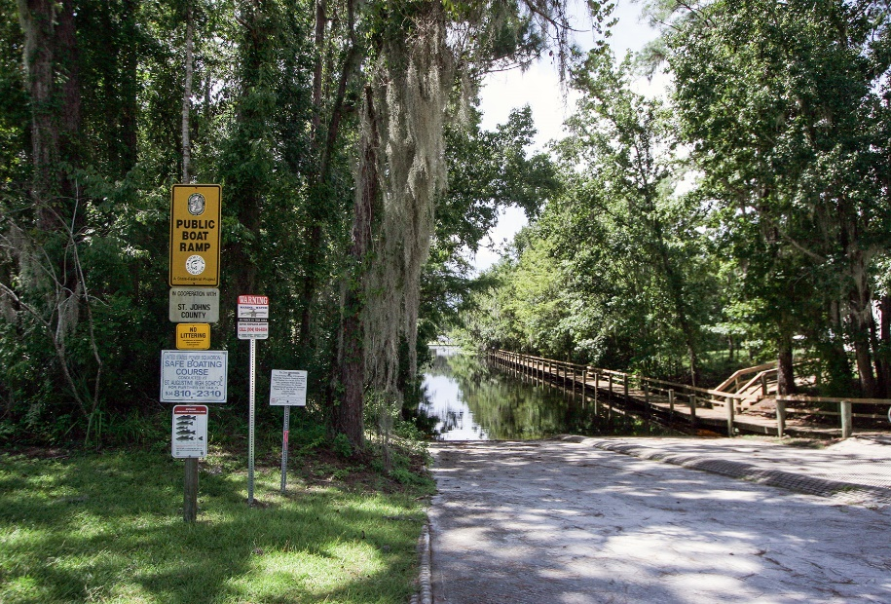
WHY DO WE CARE?
We use local waterways for swimming, fishing, boating.
It is a requirement of the County’s Phase II National Pollution Discharge Elimination System (NPDES) Stormwater Permit.
Notes:
We all want to have clean water to boat in, to swim in, to fish in, and for use by the plants and animals in our environment. Not only are we required by our permit, but it is the right thing to do for the health and safety of us and our environment. Remember our wildlife, manatees are dying for lack of food due to pollution, fish and birds are dying because of plastics in our waterbodies.
Image Credit #1: https://www.visitstaugustine.com/thing-to-do/vilano-beach-pier-pavilion
Image Credit #2: http://davesyaktales.blogspot.com/2008/09/anastasia-state-parksaint-augustine.html
Image Credit #3: https://www.visitstaugustine.com/thing-to-do/trout-creek-boat-ramp

Slide 12
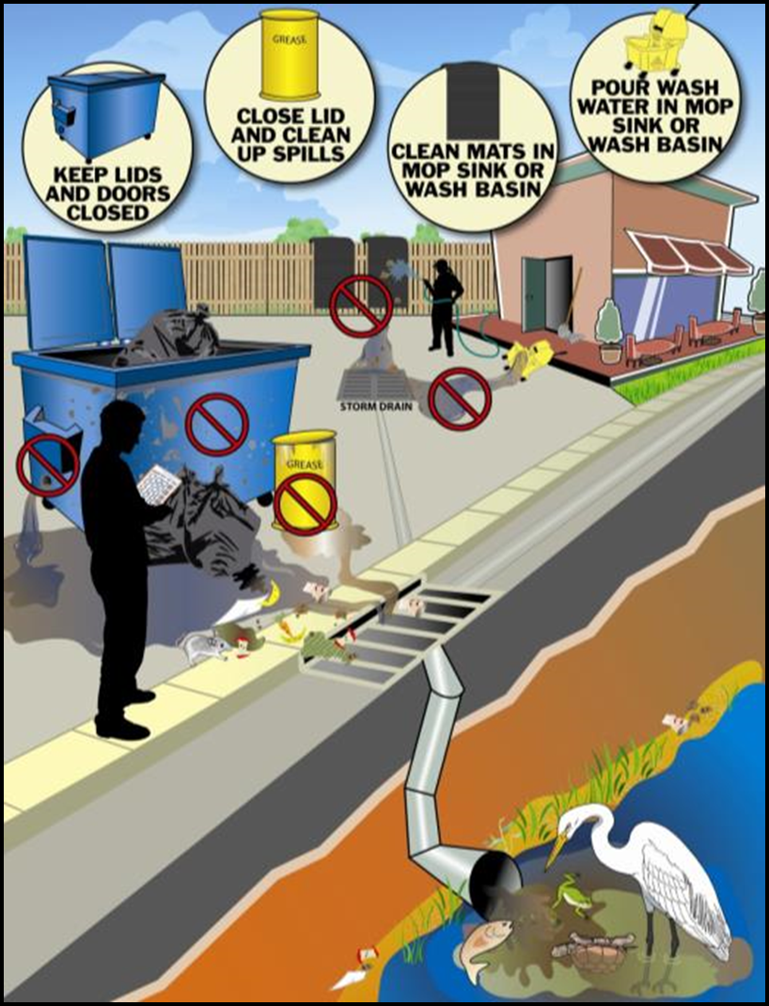
WHAT CAN WE DO?
Employees can help prevent Stormwater pollution by:
Preventing pollutants from being dumped or spilled into the storm sewer system (this includes driveways, sidewalks, streets, storm drains)
Reporting pollution or questionable
discharges to the storm sewer system or local waterways
Notes:
As a County employee, you play a major role in preventing Stormwater pollution. The first step in pollution prevention is knowing what types of activities are most likely to cause a problem. Activities like vehicle or equipment refueling and maintenance, landscaping work, and materials storage are all examples of activities that you do on a daily basis and as an employee should never cause an illicit discharge. Accidents do happen. If an illicit discharge happens, report it to your supervisor immediately and the supervisor will determine the correct method of clean up. A copy of the report will be discussed later as well as how citizens can report through the county PRIDE computer system.
Image Credit #1: http://www.wncstormwater.org/pprevention.html

Slide 13
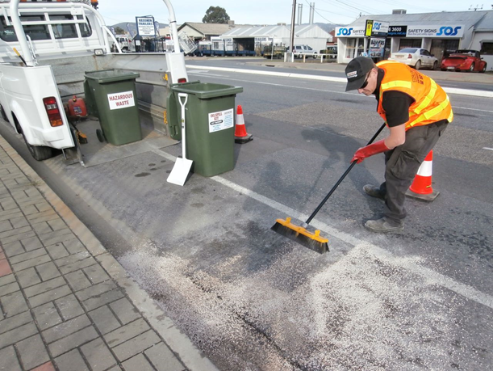
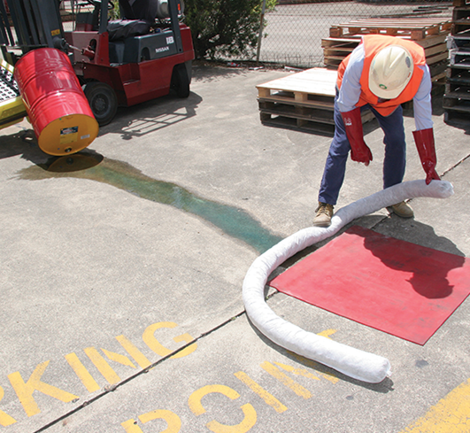
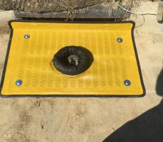
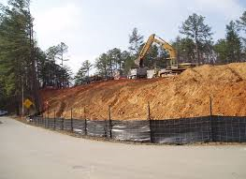
BEST MANAGEMENT PRACTICES
Store and handle materials safely
Clean up spills properly using dry methods
Never dump or wash out items down or near a storm drain
Notes:
As County employees you are responsible for using our BMPs and the first step in Stormwater pollution prevention is to make sure you are handling and storing materials safely. Avoid doing work near the storm drainage system, if you can. Wash water should be contained, collected and disposed of in the appropriate place - not into the storm drainage system. If there is a spill of a small amount of material, clean it up immediately. Always use dry cleanup methods- NEVER hose down a spill.
Image Credit #1: https://acfenvironmental.com/product/type/inlet-protection/
Image Credit #2: https://ind-fab.com/silt-fence/
Image Credit #3: http://dialatow.net.au/oil-and-chemical-spill-clean-up/
Image Credit #4: https://www.ecospill.com.au/shop/spill-kits/land-socks-fuel-oil-100mm-x-1-5m-length/

Slide 14
IF YOU SEE IT, SAY IT!
If you see discharges entering the storm drainage system or someone dumping something down the storm drain, report it
Notes:
If there is a spill of materials that goes into the storm drainage system or a body of water, or if you see someone dumping or see evidence of dumping into the storm drainage system, be sure to report it immediately to your supervisor.
Image Credit: https://ci.billings.mt.us/2432/Illicit-Discharges

Slide 15
RECOGNIZING ILLICIT DISCHARGES: WARNING SIGNS
If you see warning signs of pollution coming out of a pipe or in a local waterway, report it
Warning signs may include the presence of unusual:
Color
Odor
Turbidity
Floatable liquids and solids
Etc.
Notes:
Liquids coming out of a pipe or outfall, especially if it has not rained in several days, are a good indication that something is not right. Unusual colors, odors, cloudiness, floatable solids or liquids, or any other unusual sign that there is more than just water in a storm drain, creek or stream should be reported immediately.
Image Credit: Brandon Tirado

Slide 16
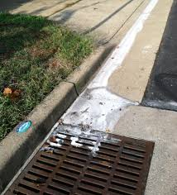
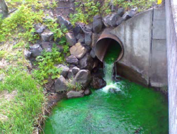
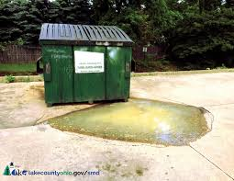
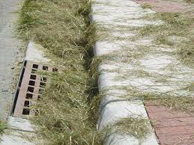
WHAT TO KEEP AN EYE OUT FOR
Notes:
Stormwater pollution can often be seen. Keep your eyes open for especially cloudy or dirty water running down the street, sidewalks or driveways. Discharges of unusually colored liquids are often a sign of pollution. Leaking dumpsters or grease bins should be reported. Sweeping or blowing leaves or grass into the street is against the law according to Ordinance 2006-62.
Image Credit #1: https://www.alexandriava.gov/tes/stormwater/info/default.aspx?id=93364
Image Credit #2: http://www.wbtownship.org/government/departments/engineering/illicit_discharge_elimination_program_(idep).php
Image Credit #3: https://www.lakecountyohio.gov/smd/Whats-Stormwater/What-is-Stormwater-Pollution
Image Credit #4: https://alachuacounty.us/Depts/epd/WaterResources/CodesAndCompliance/Pages/Grass-Clipping-Public-Outreach-Campaign.aspx

Slide 17
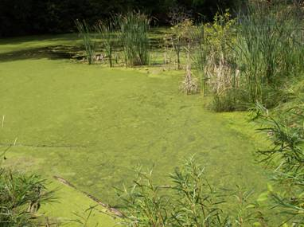
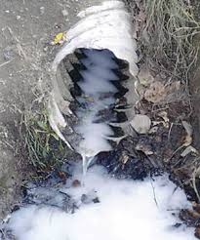
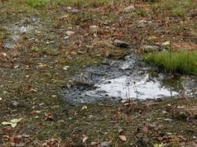
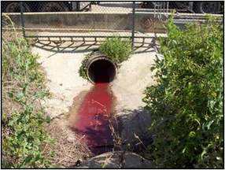
MORE OF WHAT TO KEEP AN EYE OUT FOR
Notes:
Unusual water color is always something to report. Bright green water could indicate an algae bloom. Milky white water could be paint wash water. Milky gray-black water could be an indication of a failing septic system or sewage overflow. Tan or brown water could be discharge from a construction site. Purple or red water could indicate a diesel fuel or heating oil spill.
Image Credit #1: https://www.ci.superior.wi.us/557/Illicit-Discharge-Detection-Elimination
Image Credit #2: https://www.codot.gov/programs/environmental/water-quality/stormwater-programs/idde.html
Image Credit #3: Brandon Tirado
Image Credit #4: https://trulygreensepticservices.com/septic-systems/septic-system-failures/
Image Credit #5: https://www.cityofames.org/government/departments-divisions-i-z/public-works/stormwater-program/stormwater-violations-illicit-discharge

Slide 18
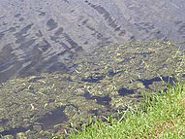
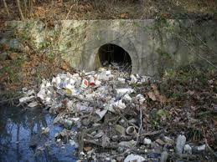
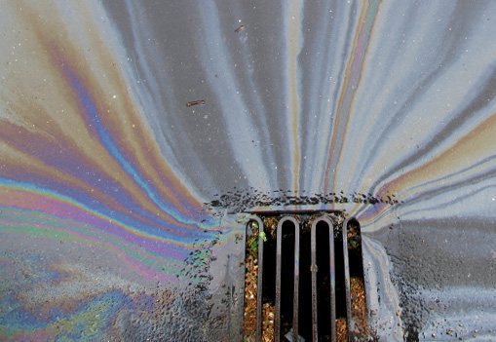
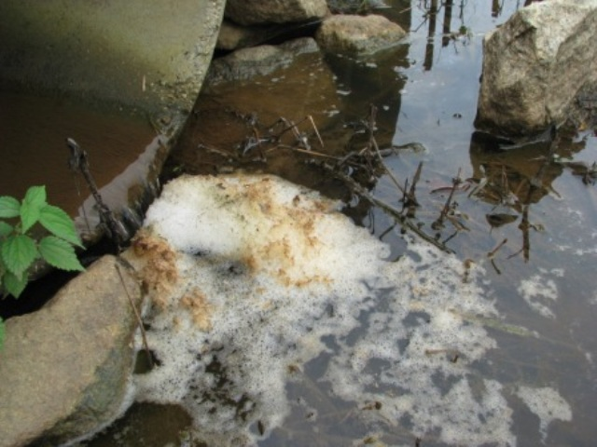
MORE OF WHAT TO KEEP AN EYE OUT FOR
Notes:
If there is something floating on top of the water, such as excessive grass, leaves or trash make sure to report it. A rainbow sheen on top of the water could indicate an oil spill. Soapy or sudsy water should be reported as well.
Image Credit #1: https://www.lofslakes.com/leaf-and-grass-clipping
Image Credit #2: https://www.conteches.com/stormwater-article/article/72/6-key-points-of-developing-a-stormwater-trash-control-strategy
Image Credit #3: https://www.codot.gov/programs/environmental/water-quality/stormwater-programs/idde.html
Image Credit #4: https://www.clemson.edu/extension/water/stormwater-ponds/problem-solving/muddy-turbid-water/index.html

Slide 19
WHAT TO KEEP A NOSE OUT FOR
Some odors are an immediate indicator of pollution
Sewage, gasoline, and chemical odors should be reported
Odor | Causes
Rotten eggs/hydrogen sulfide | Raw sewage, decomposing organic matter, lack of oxygen
Sharp, pungent odor | Chemicals or pesticides
Gasoline, petroleum | Industrial discharge, illegal dumping of wastes, waste water
Notes:
If you smell a strong or unusual odor coming from the storm drainage system or water body, report it immediately. This could be an indication of a sewage, chemical, or industrial discharge.

Slide 20
ILLICIT DISCHARGE FIELD REPORT
Notes:
A county employee can use this form to report an illicit discharge. County citizens can use the county’s PRIDE online web page, referenced on the next slide. Report as much detail as you can. Whether you are an employee or a citizen, DO NOT TRY TO INVESTIGATE THE ILLICIT DISCHARGE. Once reported the responsible county employee will handle the investigation.

Slide 21
ILLICIT DISCHARGE FORM CONT…
For additional information and NPDES Program contacts, visit:
http://www.sjcfl.us/Stormwater/index.aspx
http://www.sjcfl.us/Stormwater/SWProgram.aspx
Report complaints and concerns at:
http://www.sjcfl.us/CodeEnforcement/PRIDE.aspx
Specific location
Date and time
Description of the pollution
Description of the violator, e.g. license plate #, personal description (if applicable)
Your contact information (optional if calling in)
Email a picture or video if you can
Notes:
Regardless of your status, employee or citizen. Remember this, if you see it report it. Only storm water goes down the drain. For more information about our Stormwater prevention activities go to the websites listed on this page and the link to report Stormwater or illicit discharges complaints or concerns. And finally, be part of the solution not the problem. Clean water is every ones responsibility.

Slide 23
“We forget that the water cycle and the life cycle are one.”
Jacques Cousteau
Notes:
Thanks for listening and have a great day.

