Slide 1
City of St. Augustine Beach
Stormwater Utility Implementation
Town Hall Meeting
April 10, 2024

Slide 2
Agenda
What is a Stormwater Utility?
Why the City Needs a Stormwater Utility – The City’s Stormwater Program
Stormwater Utility Fee Calculation and Billing
Stormwater Fees in Other Local Municipalities
Next Steps
Q&A

Slide 3
Stormwater Utility Overview

Slide 4
What is a Stormwater Utility?
Enterprise fund that provides a stable, dedicated, equitable source of funding for:
Meeting State and Federal stormwater regulatory requirements
Operation and maintenance of the stormwater system
Water quality improvements (Statewide Stormwater Rule)
Improving resiliency
Sea Level Rise
More intense rainfall
Notes:
We will perceivably (measurably) improve infrastructure inundation.
We must control sediment runoff to our drainage conveyances and retention ponds.
We must replace and improve existing deteriorated drainage infrastructure.
We must stabilize our drainage canals.
Illicit connections must be reduced.

Slide 5
City of St. Augustine Beach’s Stormwater Program

Slide 6
What will the Stormwater Utility fund? Regulatory Requirements
City is subject to the National Pollutant Discharge Elimination System (NPDES) MS4 Permit:
An unfunded federal mandate
6 Minimum Control Measures
Annual Report
MS4 Permit Requires Implementation, Tracking and Reporting on all 6 Minimum Control Measures
1) Public Education and Outreach
2) Public Involvement and Participation
5) Post-Construction Stormwater Management
6) Pollution Prevention and Good Housekeeping for Municipal Facilities
3) Illicit Discharge Detection and Elimination (IDDE)
4) Construction Site Runoff Controls
Notes:
NPDES: Illicit Connections, Construction Inspections, Dry Weather Screening, Street Sweeping, Urban Forestry Program

Slide 7
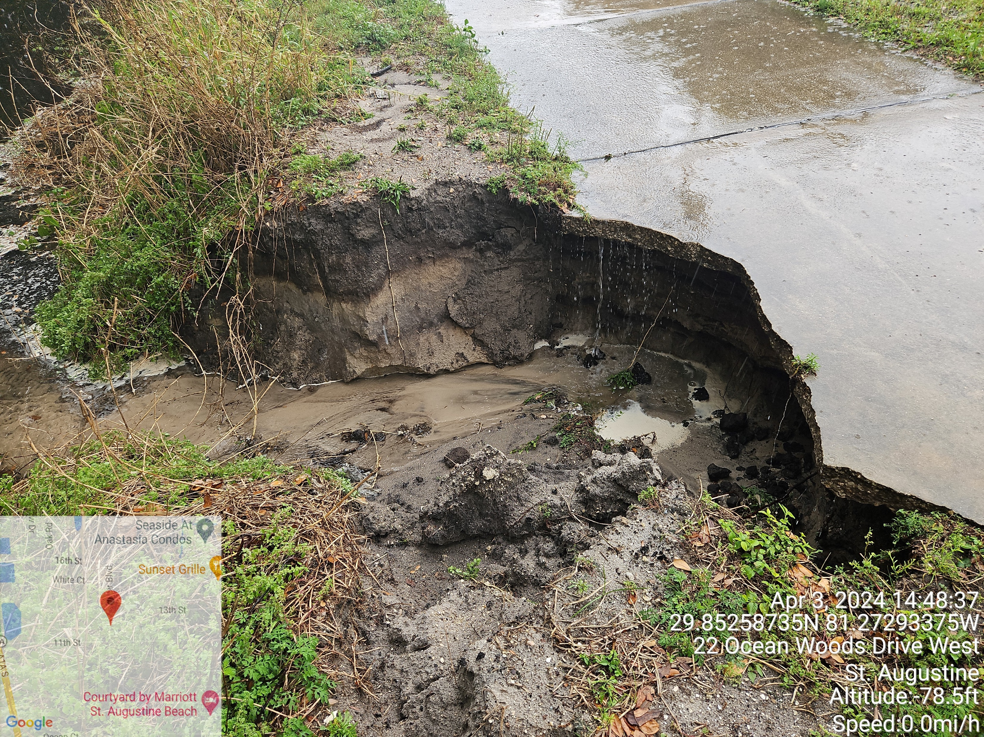
What will the Stormwater Utility fund? Operation and Maintenance Needs
Operation and Maintenance
Inspection, Cleaning and Maintenance of approximately 500 Inlets and Catch Basins
Inspection, Cleaning and Maintenance of over 40,000’ of culverts/pipes and 13,000’ of drainage ditches
Inspection, Cleaning and Maintenance of 5 ponds and 3 stormwater pump stations
Street Sweeping – 1.4 Miles of A1A Beach Boulevard
Construction Site Runoff Controls
Urban Forestry Program
Dedicated staff
Software to increase efficiencies
Notes:
This is what we need to do, but not what we are equipped and funded to do. No dedicated funding source. CIPs almost exclusively funded by Legislative Appropriations. Under prepared to bounce back after extreme rainfall events.
24 miles of roadway drainage infrastructure
CCTV Pipe Inspections
Pipe Relining
Retention Ponds
Pumping
Need more pix of October Rainfall event (Derek), inches of rainfall (Derek) and pix of maintenance activities…Ditches, inlets, ponds, pump stations, bypass pumping? (Ken/Russ/April)

Slide 8
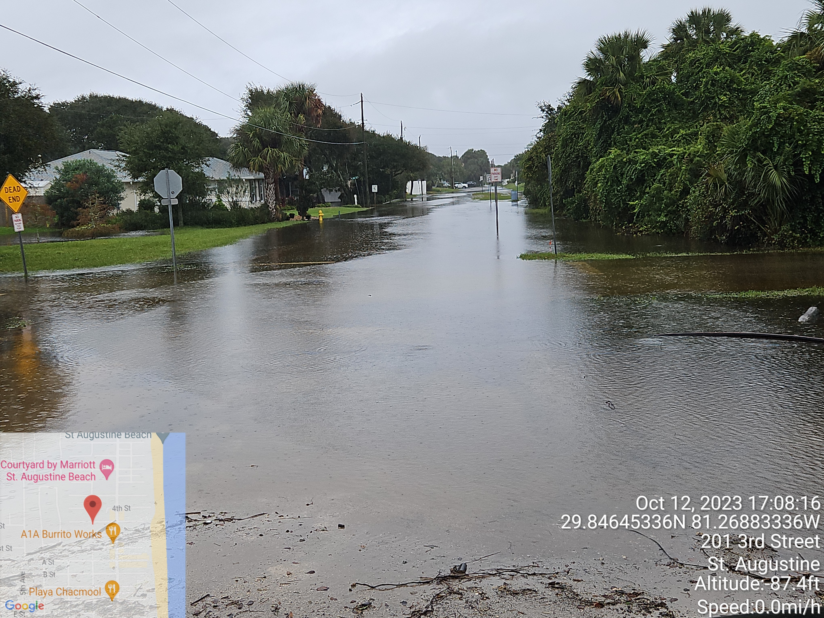
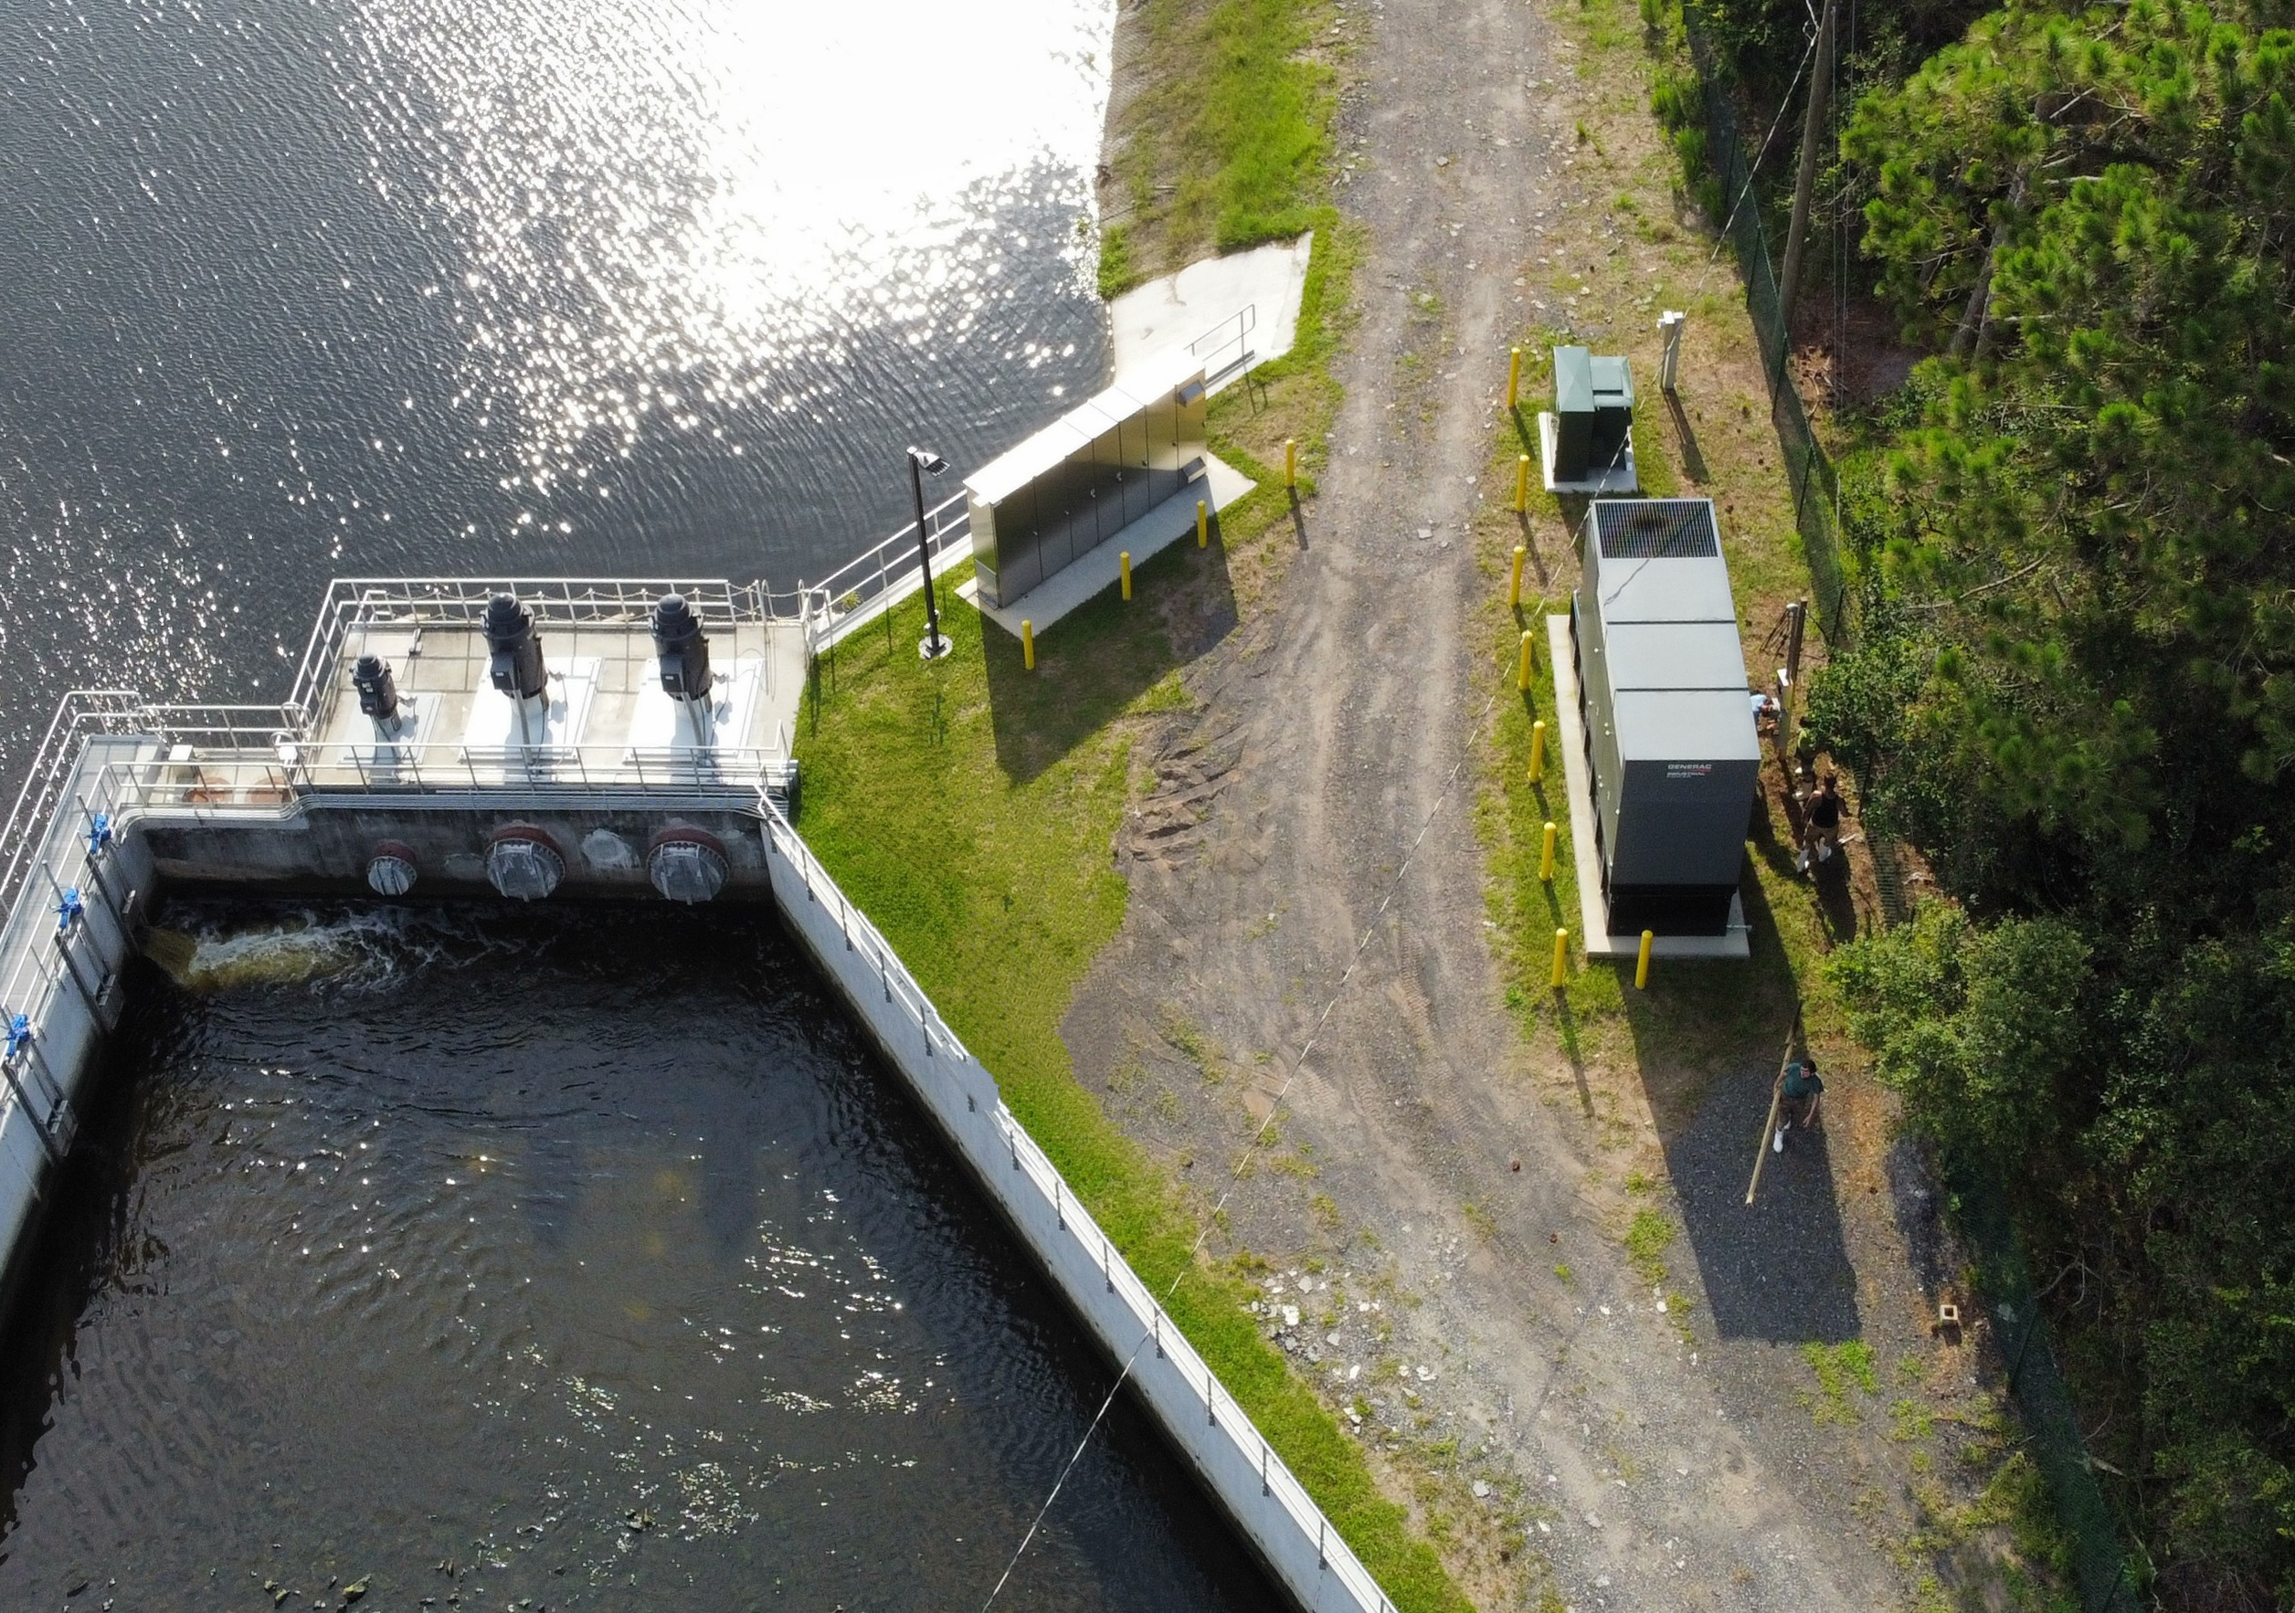
What will the Stormwater Utility Fund? Capital Needs
Drainage Improvement Projects
Mizell Pond Pump Station and Weir
Sandpiper and Linda Mar Pump Station
Mickler Blvd Ditch Mitigation
FDOT Ponds 400 and 500
Resiliency related projects (Vulnerability Assessment)
Notes:
Major Construction
Rehabilitative
Engineering
Analysis
Design
Drafting
Permitting
Specifications
DRAFT FY25-34 Budget request $24,267,748.00, ~$2.5M/yr

Slide 9
Stormwater Utility Fee Calculation and Billing

Slide 10
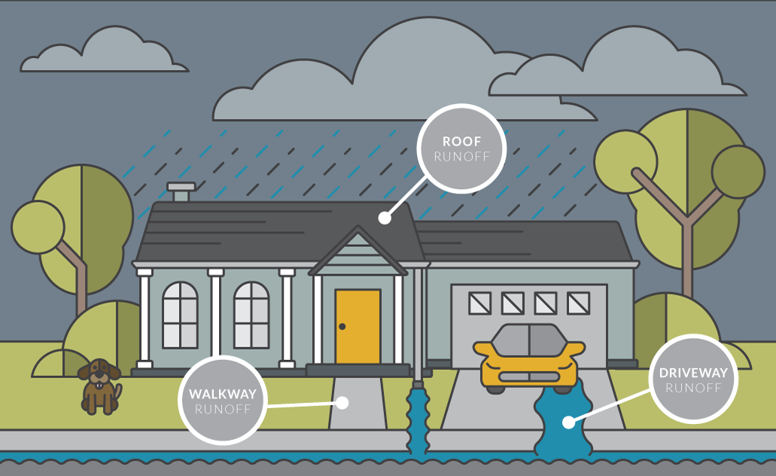
How Will My Fee be Calculated?
Impervious Area (IA) is industry standard
FSA Survey – 70% of utilities in Florida use IA based rate structure
Rational Nexus
Notes:
According to the Florida Stormwater Associations (FSA) 2022 Stormwater Utility Survey Report, 70% of Florida utilities surveyed use only impervious area as the basis for their stormwater fee. Impervious surface area is the industry standard rate structure component among those communities with stormwater fees because it bears a rational nexus to the ratepayer’s demand on the stormwater system. The more impervious area on a property, the more stormwater the property generates and the greater the demand for the utility’s stormwater services.

Slide 11
Impervious Area Defined
Hard surfaces that don’t allow infiltration of stormwater into the ground. Examples include:
Rooftops
Driveways
Patios
Private Sidewalks
Parking Lots
Compacted gravel
Excluded: swimming pool water, railroad ballast, open graded aggregate and landscaping gravel
Notes:
Impervious surface area is the most commonly used metric across the United States to charge for costs related to stormwater services. The more impervious area on a property, the more stormwater the property generates and the greater the demand for City stormwater services.

Slide 12
Customer Classes
The City is proposing developed properties be placed into one of the following customer categories based upon St Johns County Property Appraiser Data:
Single-family residential including duplex, triplex and quadplexes
Multi-family residential – condominiums
Single-family attached – townhomes and other single-family residential properties that share a common area space
Non-single family residential - commercial, institutional and industrial properties

Slide 13
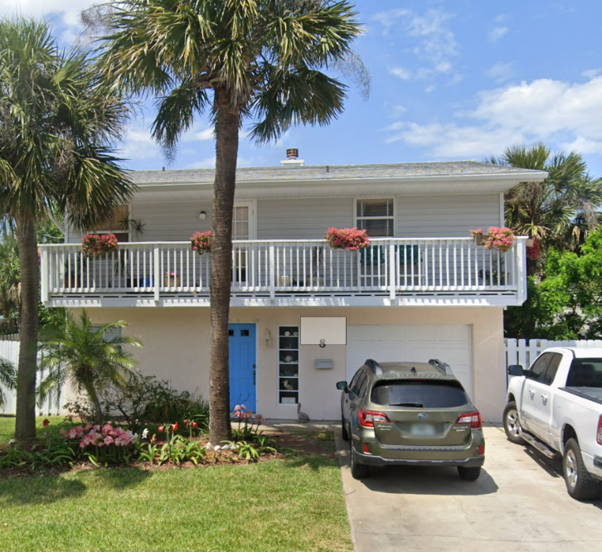
Equivalent Residential Unit (ERU)
Billing unit for IA based rate structures
Community specific
Median IA on Single-family residential properties
In City of St. Augustine Beach this value has been calculated at 3,800 square feet of IA
Notes:
Measure of the typical amount of impervious area on single-family residential property.

Slide 14
Tiering
The single-family residential customer class was found to be moderately variable in the City
City could flat rate this class (1 ERU each) or place them into tiers with variable ERUs
To balance equity, fairness and administrative complexity – City is moving forward with tiering this customer class
Tier Label | Description | Impervious Area Breakpoint | ERUs
Tier 1 | IA <= 2,500 sf | 2,500 | 0.6
Tier 2 | 2,500 sf < IA <= 5,200 sf | 5,200 | 1.00
Tier 3 | IA >5,200 sf |  | 1.6
Notes:
2594 SFR (1,067 to 12,421 SF, 15%/70%/15%)
~4900 parcels in the City, exact number to be billed is less than

Slide 15
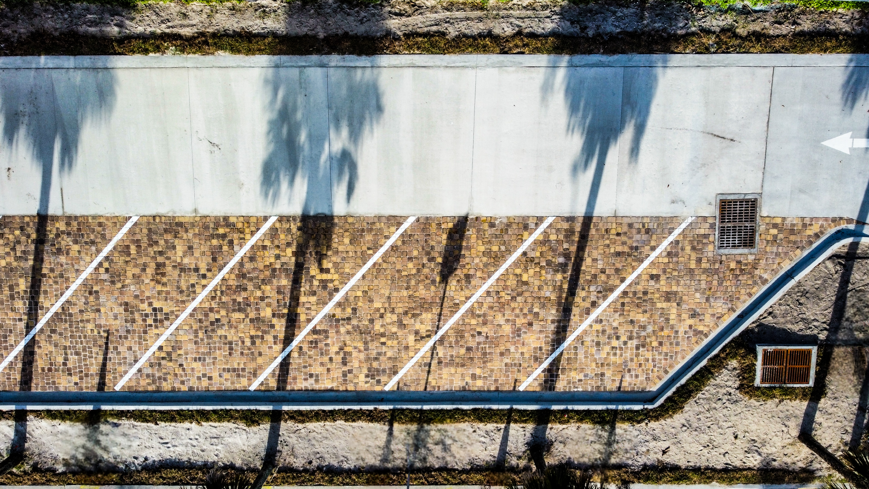
Multi-Family Residential and Non-Single Family Residential Tiering
These customer classes will be billed based upon their amount of IA relative to the ERU.
Example: A store with 38,000 square feet of IA will be billed for 10 ERUs.

Slide 16
How will I be billed?
The Stormwater Utility Fee will be assessed annually as non-ad valorem special assessment on your St. Johns County property tax bill.
Tax-exempt properties can be assessed the stormwater fee.

Slide 17
Stormwater Fee Comparison

Slide 18
Stormwater Rate Comparison
Notes:
Annual Average $170.28

Slide 19
Next Steps

Slide 20
Next Steps
Another Town Hall meeting on April 25th
City Commission Meeting on May 6th – presentation of rates
Public Hearing Notice of Non-ad Valorem Special Assessment – mailed to all developed properties – May and June
Public Hearing – August 5th
Final Reading of Ordinance – September 9
Assessment Roll delivered to County Property Appraiser – September 15

Slide 21
QA
&
21

Slide 22
Thank you!
Jones Edmunds Contact:
Mark Nelson, PE, Senior Consultant/Vice President MNelson@JonesEdmunds.com
Raftelis Contact:
Jennifer Tavantzis, Vice President jtavantzis@raftelis.com

